Slide 1
Viewpoint help guide
September 2023
viewpoint.pwc.com
Please note, we will continuously update this deck as Viewpoint is regularly updated with enhanced functionality
What’s new?
Setting up your profile
Content access level icons
Account profile icons
Finding content
Navigation
Join view
Side-by-side view
Search
My favourites
Internal and external content
Key resources
Where to get more help

Slide 2
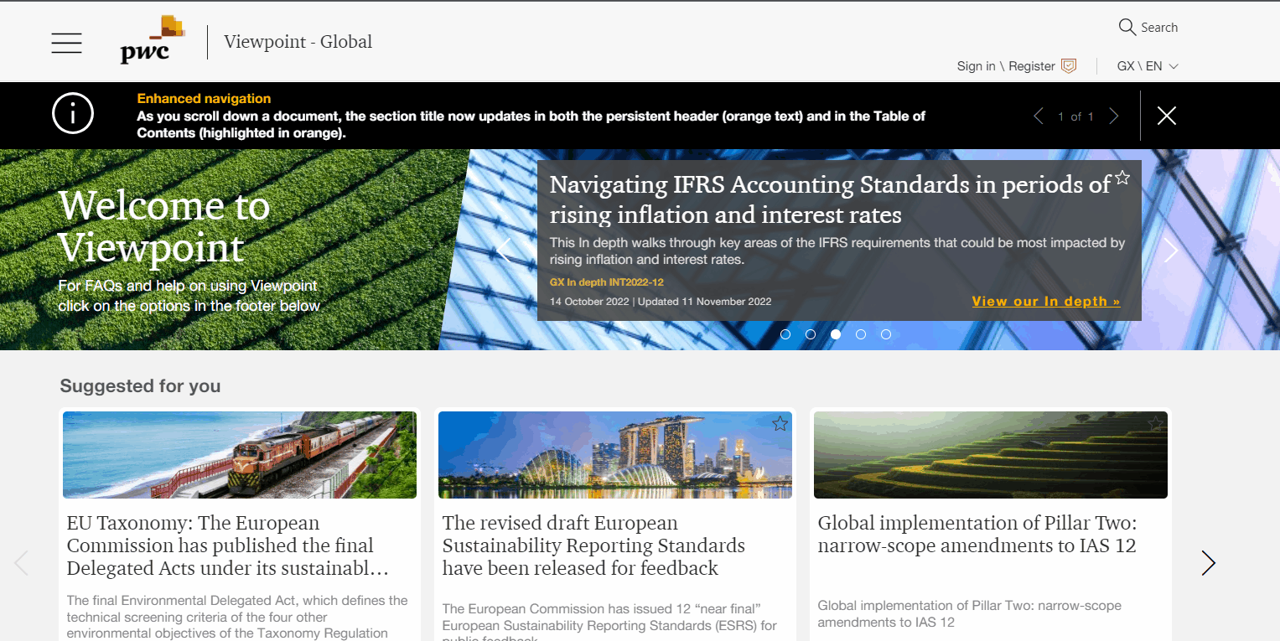
What’s new?
Enhancements to the search results screen:
To make it easier to find key content, ‘Suggested guidance’ links now appear at the top of the search results screen.
Search results now feature coloured icons indicating who can access the content:
Red icon indicates licensed content, which only licensed subscribers can access.
Grey icon indicates ‘premium’ content, which anyone can access if they register for a free account

Slide 3
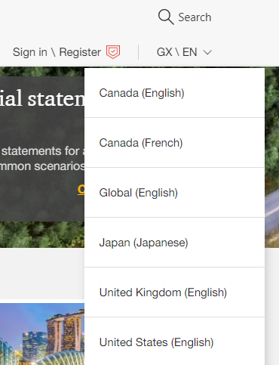
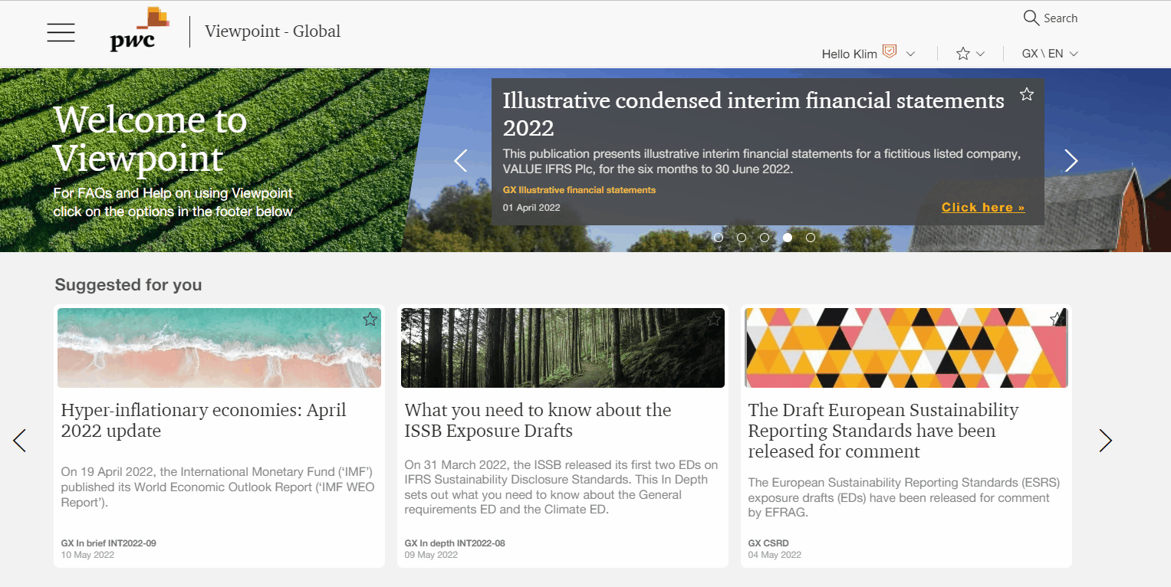
How to set your profile and territory
Check your profile is set up correctly
Navigate to your ‘Profile’ by clicking on your name. On the second pop-up screen, ensure you select your Country, as this will be the default when you use the search.
Note: If you choose more than one option, ensure you select one to “set as primary”.
External users only: Tick the ‘Newsletter’ box if you would like to subscribe to Viewpoint’s monthly email.
Internal users only: email uk_ifrs_round_up@pwc.com if you would like to receive Viewpoint’s monthly email.
Switch territory via the drop down menu located at the top right

Slide 4
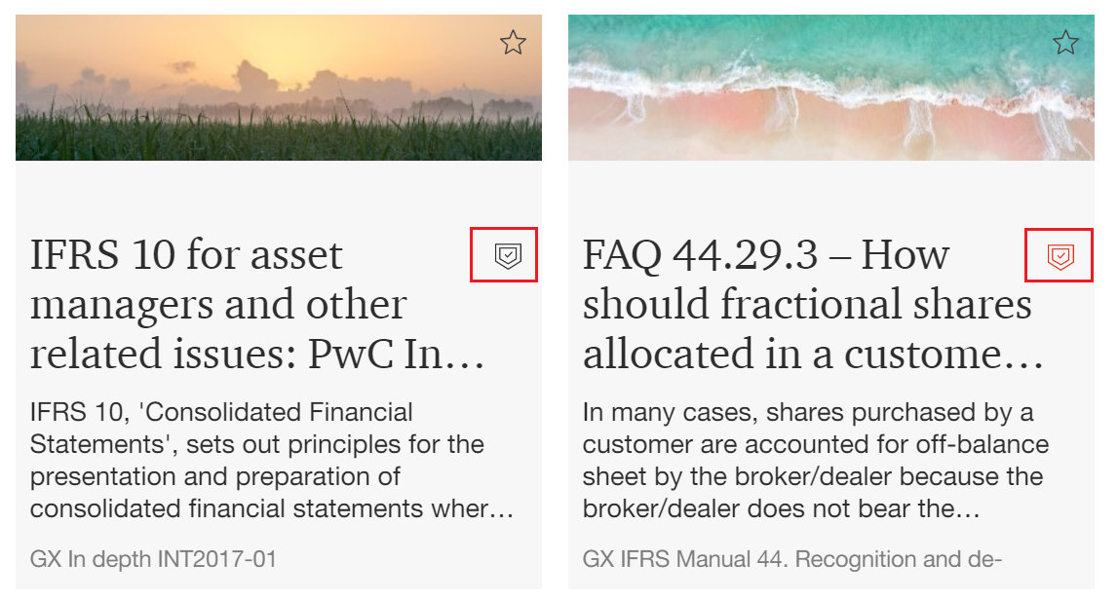
Content access level icons
The external content access levels in our ‘Home’ and ‘Landing’ pages are differentiated by coloured icons:
Red for licenced content, which means that only a licenced subscriber will be able to view this content.
Grey for content requiring free registration, which means that anyone can view this content as long as they have a free registered account.

Slide 5
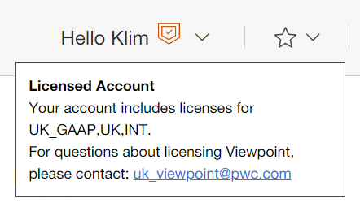
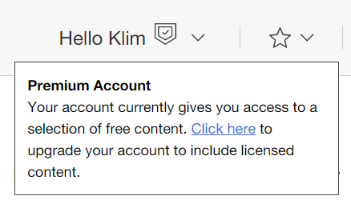
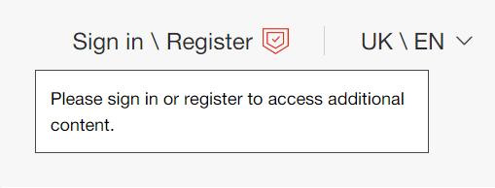
Account profile icons
Your access level is indicated by the coloured icon beside your name at the top right of the screen:
An orange icon next to your name means you have a licensed account. Hover over the icon and a box will appear listing which territory content you are subscribed to.
A grey icon next to your name means you have a Premium free account. Hover over the icon and a box will appear advising how you can upgrade to a licensed account.
A red icon next to 'Register' means you are a Free user (no account). Hover over the icon and a box will appear advising you to either sign in or register for a free Premium account.

Slide 6
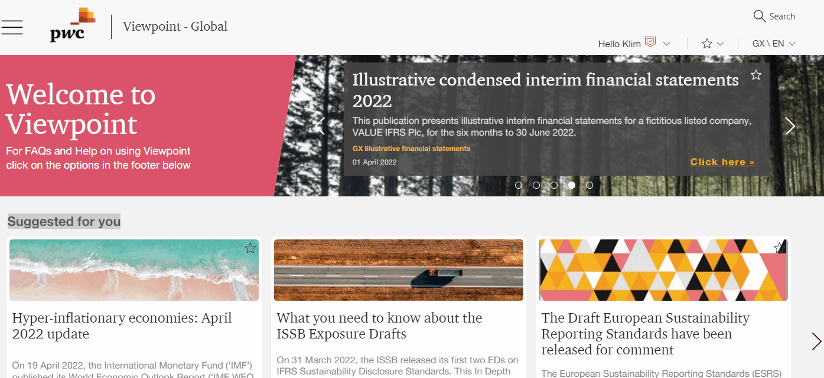
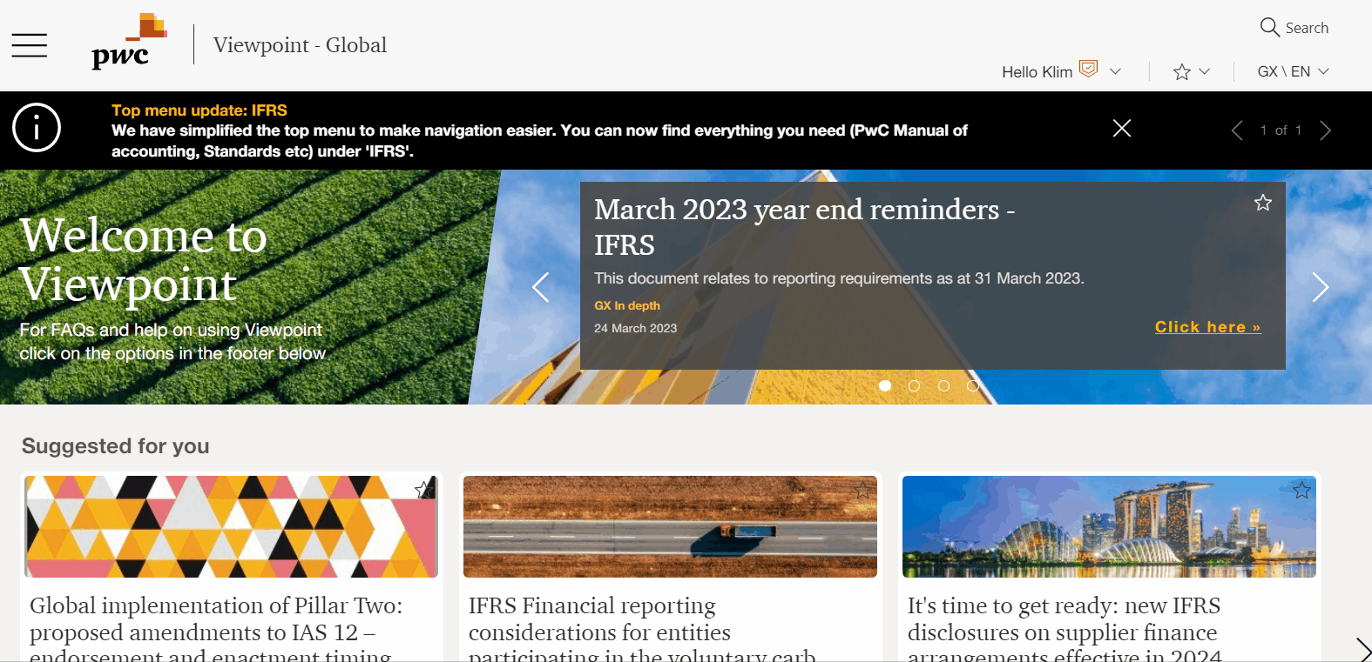
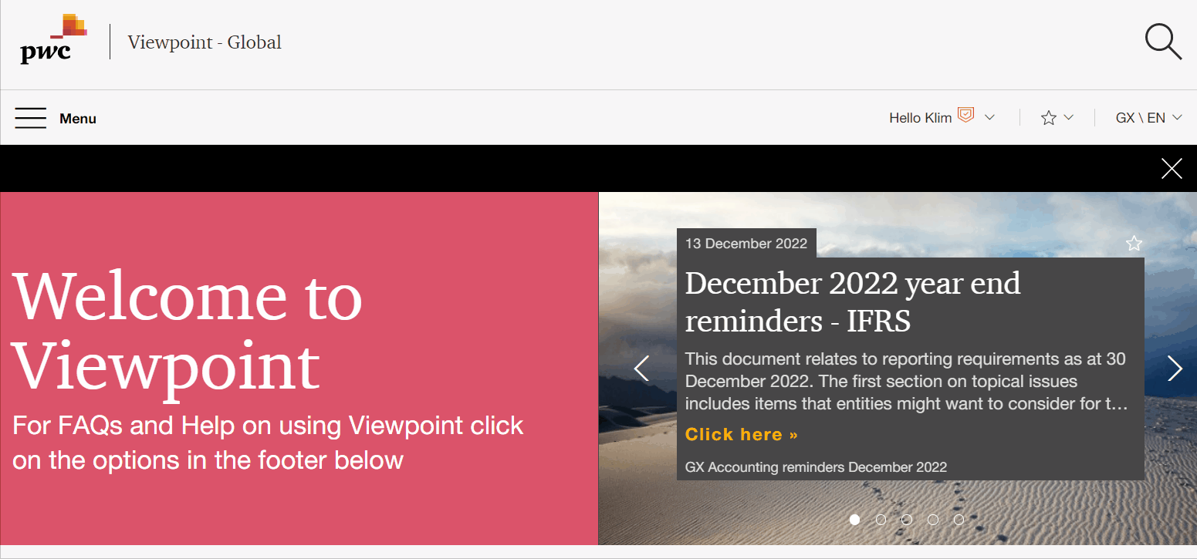
Finding content
Multiple options to help you navigate quickly and easily
Search - see the next slides for more information.
Main menu - split into sections, making it easy to find auditing or accounting specific content
Topic/industry landing pages - ‘Where to start’ pages kept up to date with newly published items. Access via Menu > Latest updates
Sitemap - visible on every page in the footer of Viewpoint.

Slide 7
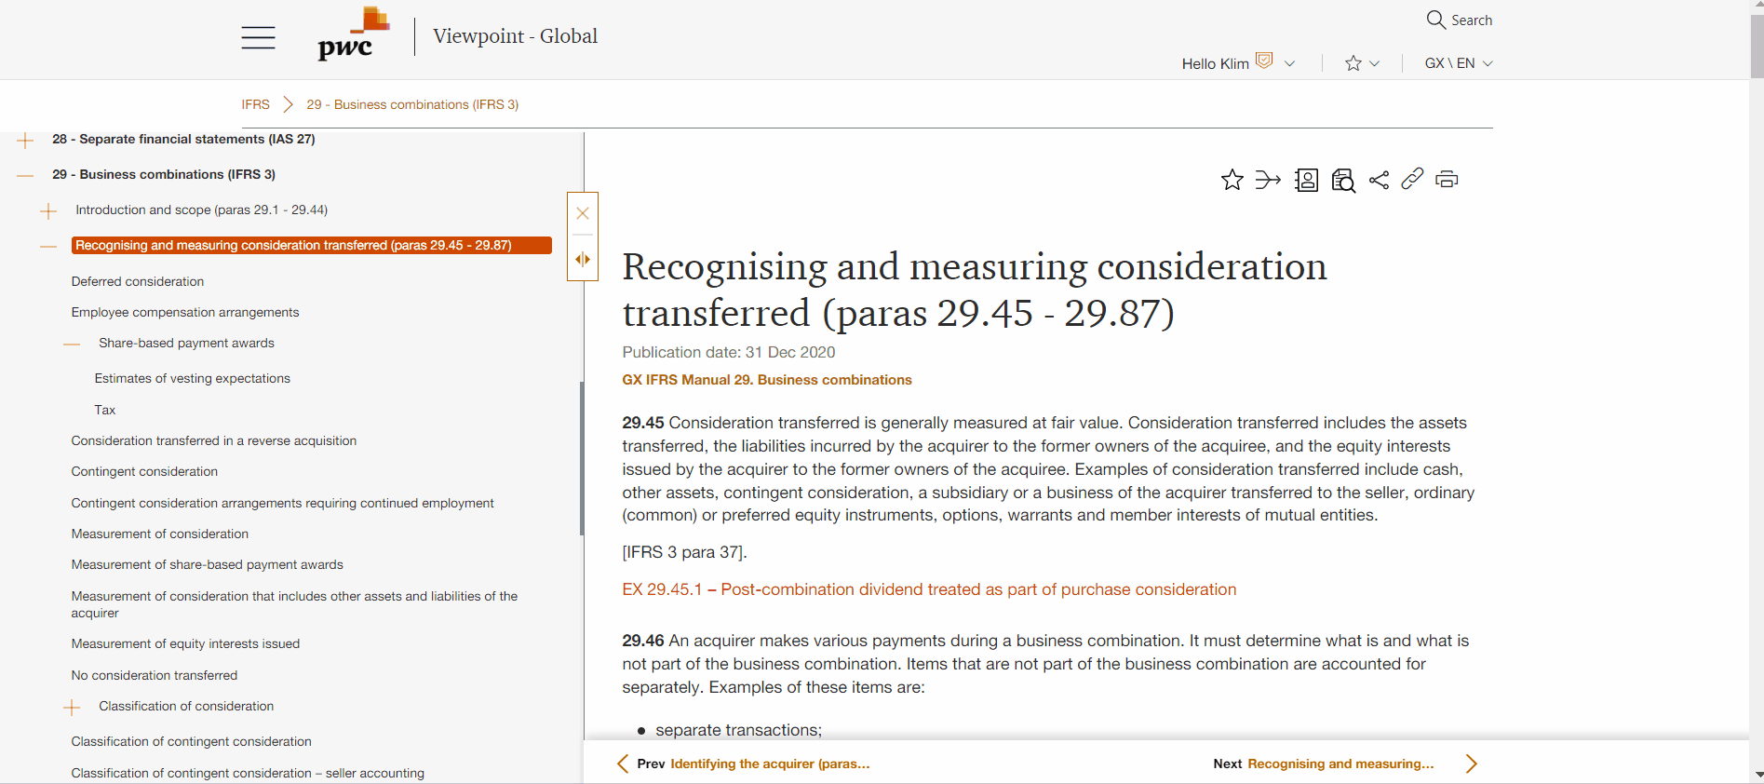
Navigation
As you scroll down a document, the section title now updates in both the persistent header (orange text) and in the Table of Contents (highlighted in orange). This makes it easier for you to know exactly where you are within a document.

Slide 8
Join view
View full Manual of accounting chapters or standards in one screen
‘Join view’ allows you to view certain areas of content, such as a Manual chapter or a standard, in their entirety.
This view will allow you to search and print (including to pdf) the whole document.
Click on this icon to open the full document in a new tab in your browser.
Inline links within Join view can also be opened in side-by-side view.

Slide 9
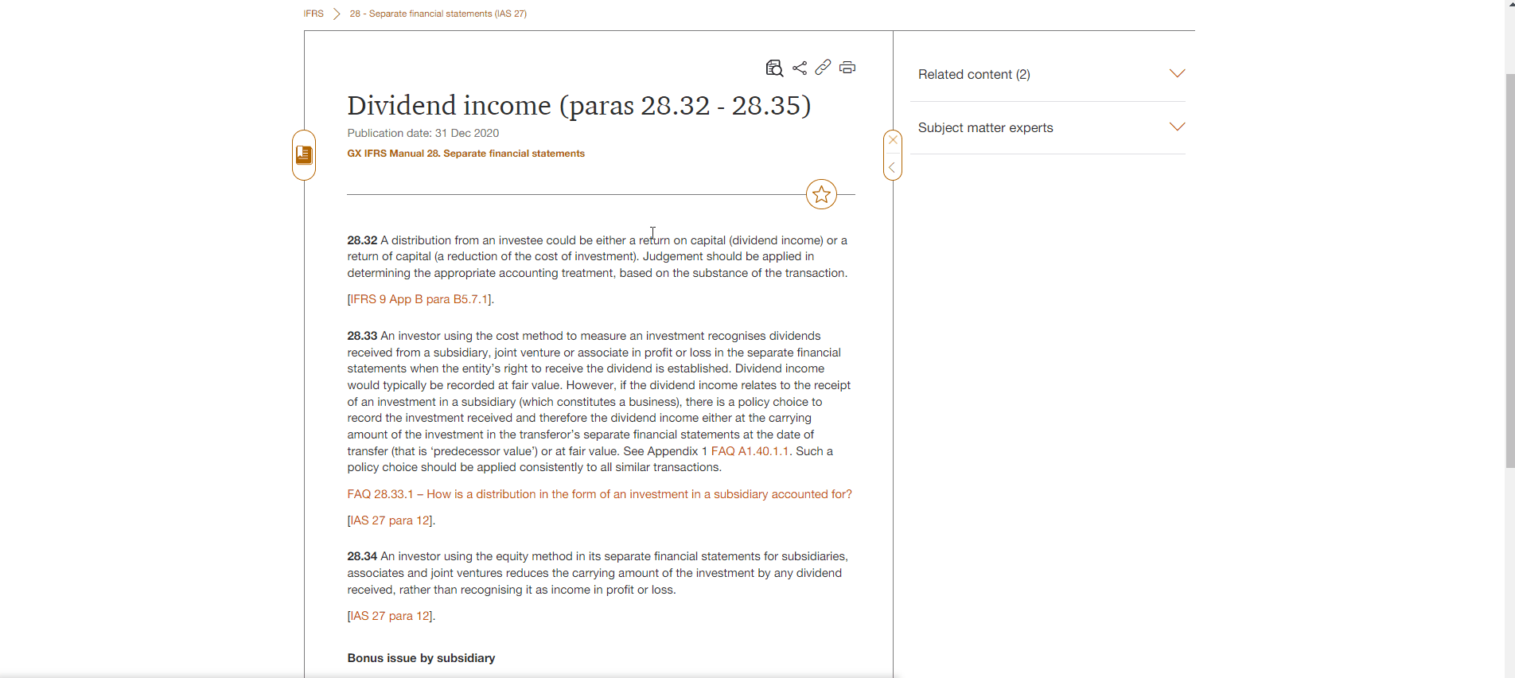
Side-by-side
View two documents in one screen
Links can now be opened in a ‘side-by-side’ view so it is now easier to cross reference two documents.
When you hover over a link, there is now the option to ‘go to content’ directly or open the content in ‘side-by-side’ view. From within the ‘side by side’ view, you can also go directly to the linked content via the ‘go to content’ icon located in the top right corner.

Slide 10
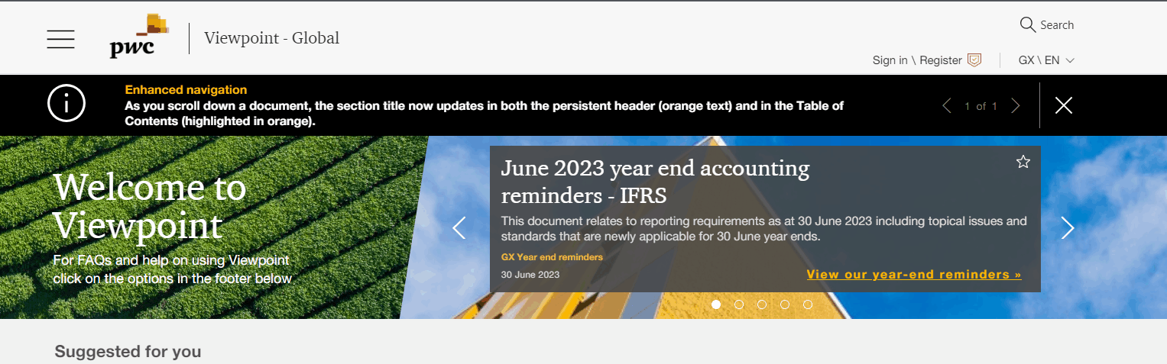
Search
How it works
Viewpoint uses keywords and tags to generate a list of pages that closely relate to your search term.
By default, the site will present results that include all the words you entered, but not necessarily in that exact order. For example, a search for revenue from contracts with customers will find all pages that separately include all the words ‘revenue’, ‘contracts’ and ‘customers’.
To search more specifically, you can add quotation marks around your search term, for example "revenue from contracts with customers". This will produce a list of pages that contain this exact phrase only.
See the next slide to learn how to use filters to refine your search results.

Slide 11
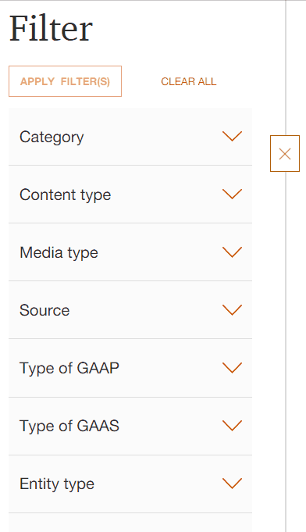
Search
Filters
All content on Viewpoint is comprehensively tagged to allow you to narrow down the search results to fit your requirements. One filter applied by default which is your territory.
You can add multiple filters - click ‘Apply X filter(s)’ to see your selections take effect on the list of results.You can close the ‘Filter’ pane if you want to maximise your search results page.
Note: These filters will only include options present in your initial list of results.
Category - limit results to only accounting, audit, law and regulation etc.
Content type - if you know the specific type of content you are looking for e.g. template, ‘In brief’, FAQ, Manual chapter. If you are looking for content not created by PwC, select the option ‘external’.
Media type - a majority of our content will be tagged as ‘text’ but if applicable you will see options for videos, webcasts and podcasts.
Source - can differentiate between publications from PwC and external sources such as standard setters/regulators (for example, IASB, FRC).
Type of GAAP/Type of GAAS - narrow results to specific a specific GAAP or GAAS (for example, IFRS, ISA, UK GAAP)
Entity type - narrow the results to the relevant entity type, for example investment trust, partnership
Industry - narrow the results to the specific industry (for example insurance, banking).
Topic - narrow the results by the specific accounting/auditing topic (for example presentation, disclosure).
Country - this will be pre-populated with the territory selected in your profile.

Slide 12
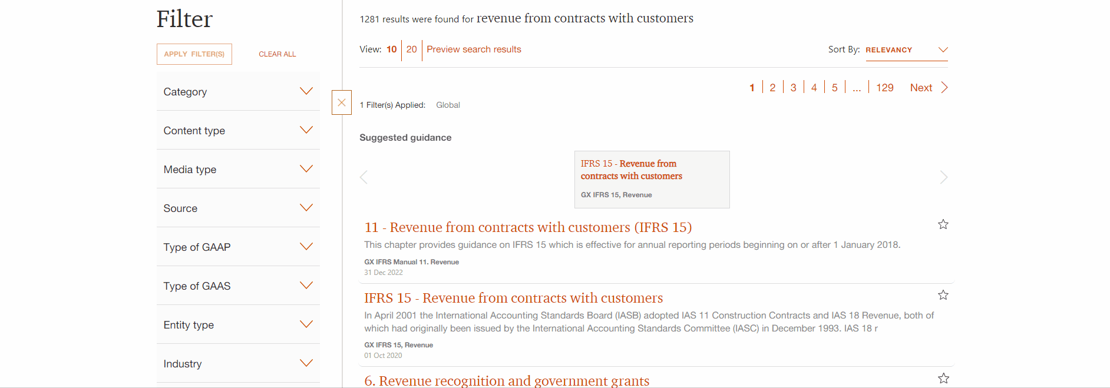
Preview search results
Not sure if a search result is what you’re looking for? You can now open a preview of the content alongside the search results so it is easier to find the content you want. You can choose to:
select the ‘Preview search results’ button to view the content for the search results list
go directly to the document by selecting the ‘Go to content’ button or
select the ‘Preview’ button to see a preview of the content for a specific search result

Slide 13
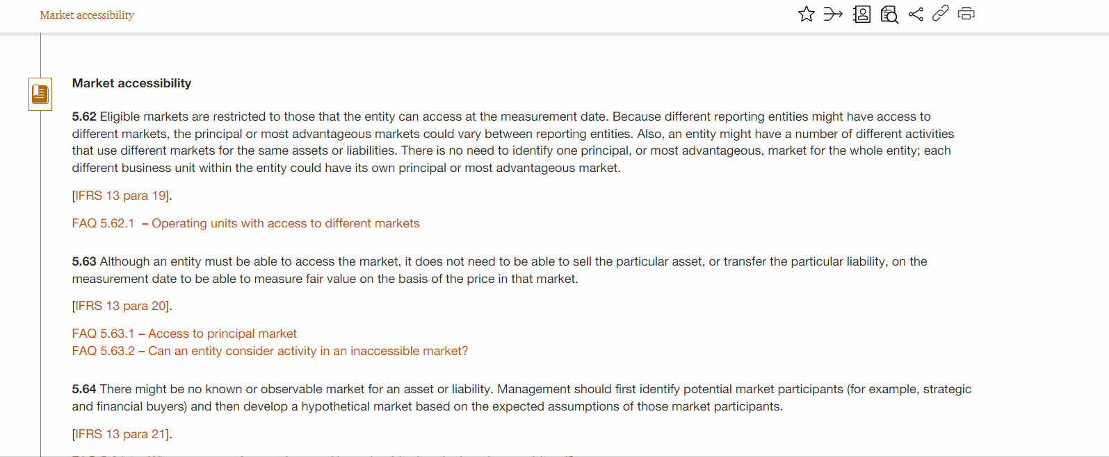
Search within section
How to search within a specific section
To search within a specific section, like a whole Manual chapter (see example below) or standard, click on the ‘search within section’ icon.
An orange box will open up with the map of the ‘table of contents’ of the page you are looking at.
Click on a specific heading you’d like to search within and there will be the option for you to enter in your search terms.
If you select a section with an expandable + icon, then the search will pull everything incorporated under that section.
If you would like to edit your search, you will have to click ‘Back to document’ and repeat the process.

Slide 14
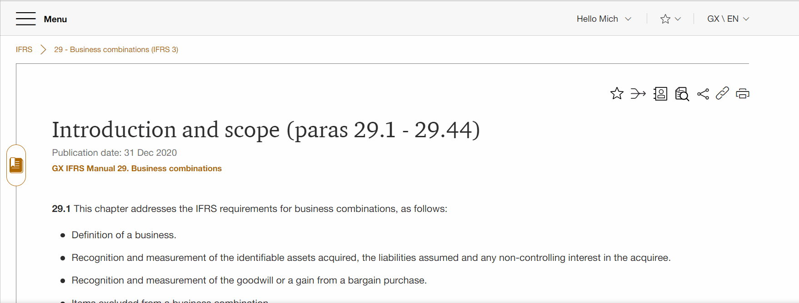
My favourites
Bookmark your favourite documents
All Viewpoint pages have a star icon which turns yellow when clicked, indicating you have added this page to your ‘My favourites’ list.
To access this list, click on the star icon to the right of your profile name, from wherever you are in Viewpoint.

Slide 15
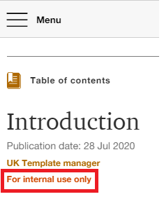
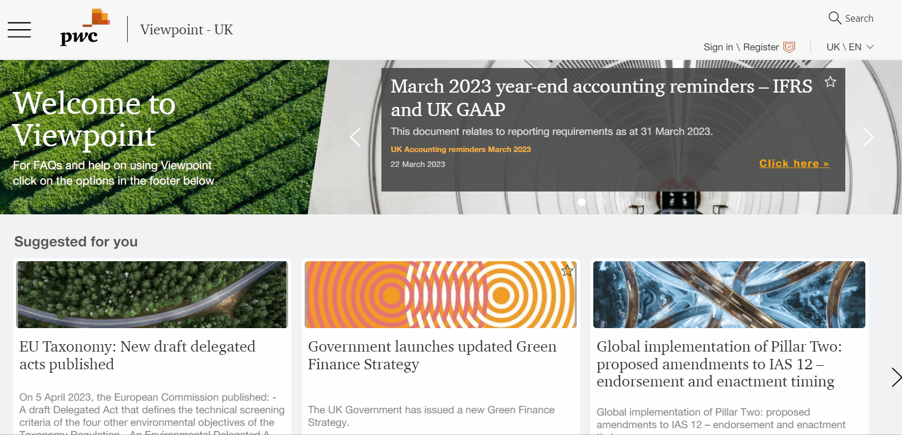
How to identify internal and external content
Confirm the intended audience of a page before sharing
All of our internal content clearly states underneath the title that the page is ‘For internal use only’.
Content which is available for external users does not have a message relating to its access underneath its title.
Instead the pages have a share icon which will allow you to easily share links via email, LinkedIn or Twitter. If you do not see this icon, the page is not available externally.
We recommend using this icon to share or send links to colleagues and clients as this will help us ensure that access to the pages is restricted to their intended audience.
The site’s licensing model utilises both free and paid-for content. External users who wish to access premium free content will be prompted to create an account with us in order to view.
Also on our ‘Home’ and ‘Landing’ pages prior to login, external content access levels are indicated by coloured icons - see this section.

Slide 16
More information
Key resources:
Quick reference card - labels out key features on the page
Quick reference card for company administrators’ - labels out key features for company administrators
FAQs - list of popular questions and answers including how to print/pdf a document.
Marketing page
Tutorial - an interactive walkthrough of the site can be found in the footer on all Viewpoint pages
Where can I get more help?
Internal only - Ask a champion (CAN network)
Email - uk_viewpoint@pwc.com
Feedback form - available in footer on all Viewpoint pages

Slide 17
https://viewpoint.pwc.com
© 2023 PwC. All rights reserved. Not for further distribution without the permission of PwC. “PwC” refers to the network of member firms of PricewaterhouseCoopers International Limited (PwCIL), or, as the context requires, individual member firms of the PwC network. Each member firm is a separate legal entity and does not act as agent of PwCIL or any other member firm. PwCIL does not provide any services to clients. PwCIL is not responsible or liable for the acts or omissions of any of its member firms nor can it control the exercise of their professional judgment or bind them in any way. No member firm is responsible or liable for the acts or omissions of any other member firm nor can it control the exercise of another member firm’s professional judgment or bind another member firm or PwCIL in any way.

